Slide 1
Problem Statement
Title : Intel Products Sentiment Analysis from Online Reviews
Presented By
Name : Uppili srinivasan M
E-mail :Sit21ad031@sairamtap.edu.in
Dept : AI-DS

Slide 2
Problem Statement
Title : Intel Products Sentiment Analysis from Online Reviews
Objective
The Objective of the project is to analyze the online customer reviews of Intel processor(intel-core-i5,i7,i9 from 12,13,14th generation) from various E-commerce websites(like Amazon,Flipkart,etc.,) and reviews sites . Final output should be informative to business executives which includes overall sentiments of each variant of processor , Features which make the reviews as Positive,Negative,Neutral.

Slide 3
Unique Idea Brief (Solution)
Customer review data are scrapped from websites using “Amazon web scrapper from Apify” which is a Online Amazon review scrapper from the desired links and export as .csv file. Those data are preprocessed and cleaned using python libraries like pandas,NLTK,scikit-learn.Using Vader sentiment analyzer compute the compound score for each reviews and classify the reviews as per each variant and as technical and general users. Finally,Extract the features using Countvectorizer and perform the Exploratory Data Analysis(EDA) using Matplotlib ,Seaborn.

Slide 4
Features Offered
Data Preprocessing
Assigning Sentiment Scores
Classify the reviews
Feature Extraction
Exploratory Data Analysis
Visualization

Slide 5



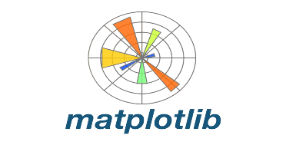

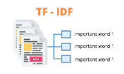
Process flow
Data collection
Using
Sentiment analysis using VaderSentiment
Create and
Evaluation of model using SVM Model
1
2
3
4
5
6
Data preprocessing
Using
FeatureExtraction using
Tf-idfvectorizer
EDA &
Visualization using

Slide 6
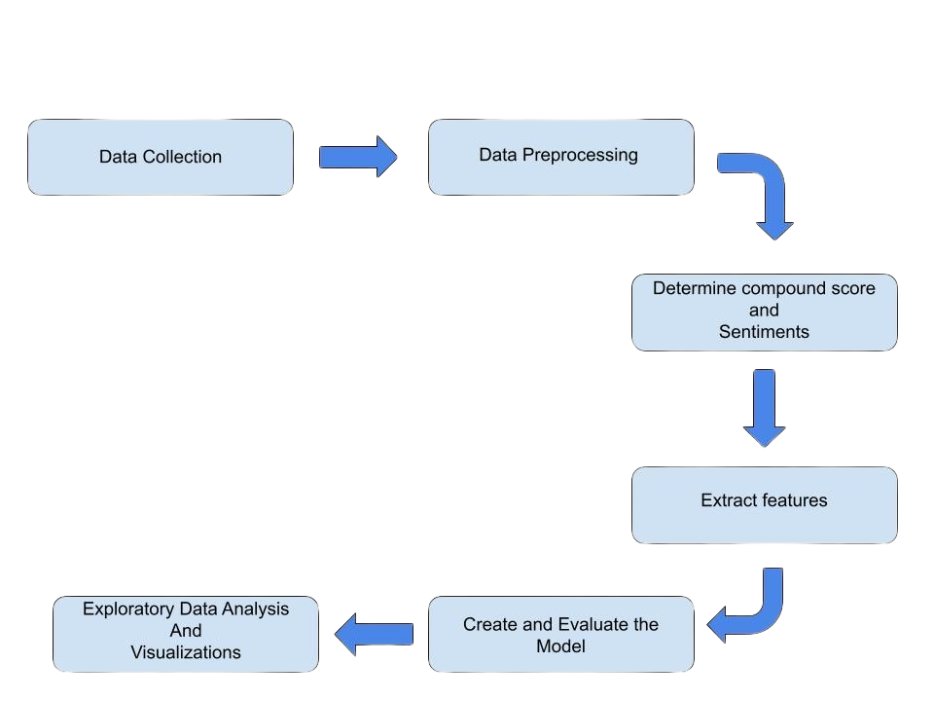
Architecture Diagram

Slide 7
Technologies used
Python :
Python is a versatile programming language widely used for data analysis,machine learning, and web development
Vader Sentiment analyser :
VADER, part of the NLTK library, is a lexicon-based tool for sentiment analysis.
NLTK :
NLTK is a powerful Python library for natural language processing (NLP).It provides tools for tasks like tokenization, stemming, tagging, and parsing.
SVM model :
SVM is a popular machine learning algorithm for classification and regression..
Scikit-learn :
Scikit-learn (or sklearn) is a comprehensive ML library in Python.
Matplotlib :
Matplotlib is a plotting library for creating visualizations in Python.Use it to visualize sentiment analysis results

Slide 8
Conclusion
The Intel products reviews are scrapped from the Amazon website among various product pages .And successfully cleans, processes, and analyzes the review data.
Sentiment analysis reveals the distribution of positive, negative, and neutral sentiments across different Intel processor variants. Classification of reviews into technical and general categories allows for more targeted analysis.
The SVM classifier's performance metrics provide insight into its accuracy and reliability in predicting sentiments.
Word clouds and sentiment distribution plots help in understanding common themes and overall sentiment for each variant.

